Slide 1
IBM InfoSphere Information Server
Lesson 7: Repository Functions, Metadata in the Parallel Framework, Job Control

Slide 2
Lesson Objectives
After completing this unit, you should be able to:
Perform a simple Find
Perform an Advanced Find
Perform an impact analysis
Compare the differences between two Table Definitions
Compare the differences between two jobs

Slide 3
IBM InfoSphere Information Server
7.1 : Searching the Repository

Slide 4
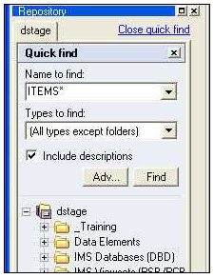
Quick Find
Name with wild
card character (*)
Include
matches in
object
descriptions
Execute
Find
Notes:
If the Include descriptions box is checked, the text in Short descriptions and Long descriptions will be searched.

Slide 5
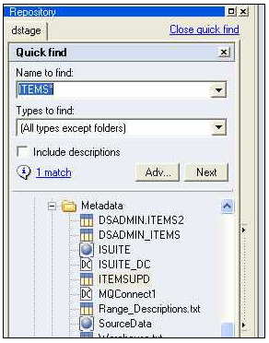
Found Results
Highlight
next item
Number
found; Click
to open
Advanced
Find window
Found
item

Slide 6
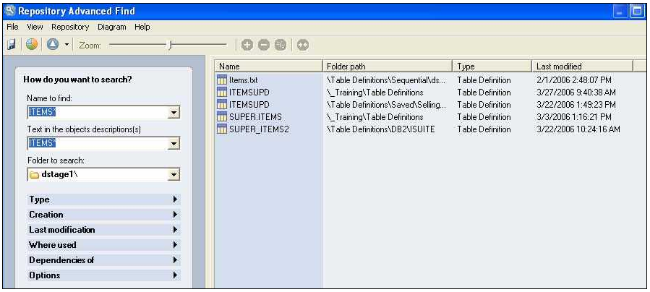
Advanced Find Window
Filter
search

Slide 7
Advanced Find Filtering Options
Type: type of object
Job, Table Definition, etc.
Creation: range of dates
E.g., Up to a week ago
Last modification: range of dates
E.g., Up to a week ago
Where used: objects that use specified objects
E.g., a job that uses a specified Table Definition
Dependencies of: objects that are dependencies of objects
E.g., a Table Definition that is referenced in a specified job
Options
Case sensitivity
Search within last result set

Slide 8
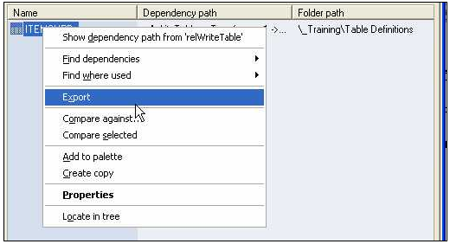
Using the Found Results
Create
impact
analysis
Export to
a file
Draw
Comparison

Slide 9
IBM InfoSphere Information Server
7.2 : Impact Analysis

Slide 10
Performing an Impact Analysis
Find where Table Definitions are used
Right-click over a stage or Table Definition
Select “Find where Table Definitions Used” or
Select “Find where Table Definitions Used (deep)”
Deep includes additional object types
Displays a list of the objects using the Table Definition
Find object dependencies
Select “Find dependencies” or
Select “Find dependencies (deep)”
Displays list of objects dependent on the one selected
Graphical functionality
Display the dependency path
Collapse selected objects
Move the graphical object
“Birds-eye” view

Slide 11
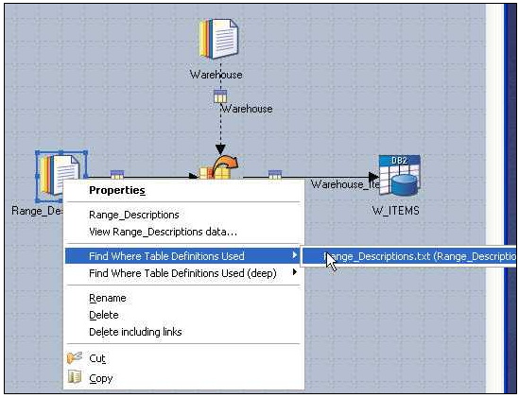
Initiating an Impact Analysis from a Stage
Select Table
Definition

Slide 12
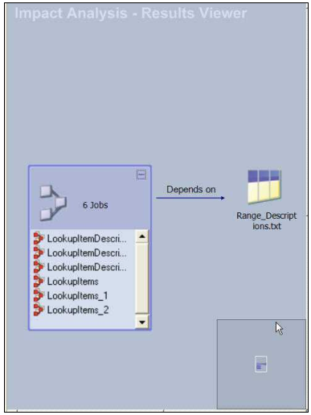
Displaying the Dependencies Graphically
Table
Definition
List of
dependent
objects
Birds
Eye view

Slide 13
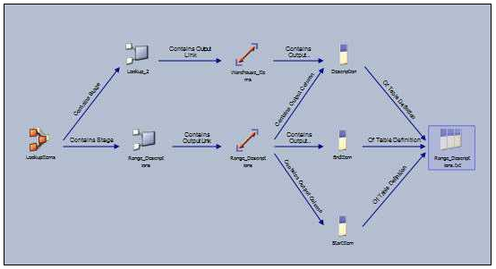
Displaying the Dependency Path
Table
Definition
Job containing
(dependent on)
Table Definition

Slide 14
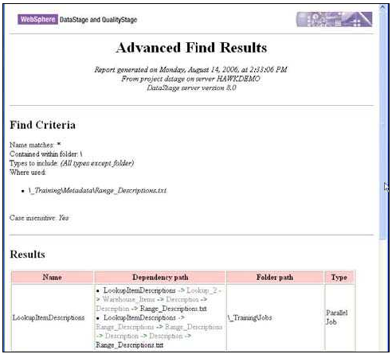
Generating an HTML Report

Slide 15
IBM InfoSphere Information Server
7.3 : Job and Table Difference Reports

Slide 16
Finding the Difference Between Two Jobs
Example: Job1 is saved as Job2. Changes are made to Job2. What changes have been made?
Here Job1 may be a production job. Job2 is a copy of the production job after enhancements or other changes have been made to it

Slide 17
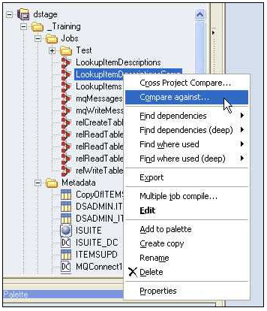
Initiating the Comparison
Job with
the
changes

Slide 18
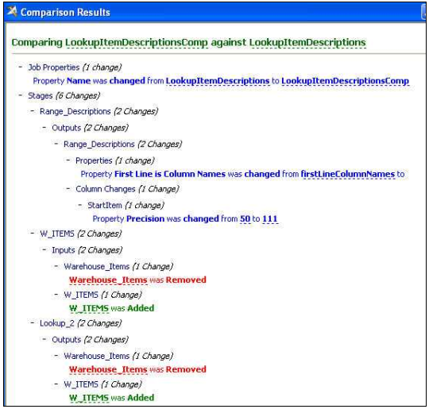
Comparison Results
Click stage and
link references to
highlight in open
jobs
Click underlined item to open stage editor

Slide 19
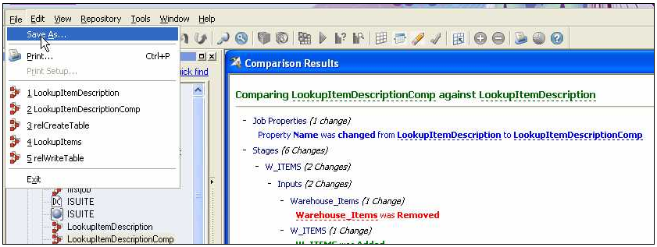
Saving to an HTML File
Click when Comparison window
is active

Slide 20
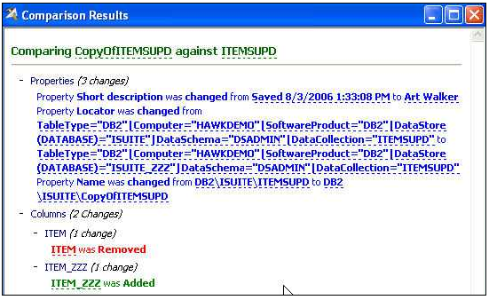
Comparing Table Definitions
Same procedure as when comparing jobs

Slide 21
IBM InfoSphere Information Server
7.4 : Metadata in the Parallel Framework

Slide 22
Unit objectives
After completing this unit, you should be able to:
Explain schemas
Create schemas
Explain Runtime Column Propogation (RCP)
Turn RCP on and off
Build a job that reads data from a sequential file using a schema
Build a shared container

Slide 23
Schema
Alternative way to specifying column definitions and record formats
Similar to a Table Definition
Written in a plain text file
Can be imported as a Table Definition
Can be created from a Table Definition
Can be used in place of a Table Definition in a
Sequential file stage
Requires RCP
Schema file path can be parameterized
Enables a single job to process files with different column definitions
Notes:
The format of each line describing a column is:
column_name:[nullability]datatype;
column_name.
This is the name that identifies the column. Names must start with a letter or an underscore (_), and can contain only alphanumeric or underscore characters. The name is not case sensitive. The name can be of any length.
nullability.
You can optionally specify whether a column is allowed to contain a null value, or whether this would be viewed as invalid. If the column can be null, insert the word ’nullable’. By default columns are not nullable.
You can also include ’nullable’ at record level to specify that all columns are nullable, then override the setting for individual columns by specifying ‘not nullable’. For example:
record nullable (
name:not nullable string[255];
value1:int32;
date:date
)
datatype.
This is the data type of the column.

Slide 24
Creating a Schema
Using a text editor
Follow correct syntax for definitions
Not recommended
Import from an existing data set or file set
On DataStage Manager import > Table Definitions >
Orchestrate Schema Definitions
Select checkbox for a file with .fs or .ds
Import from a database table
Create from a Table Definition
Click Parallel on Layout tab
Notes:
Another good way of capturing a schema is to set $OSH_PRINT_SCHEMAS and copy entries from the DataStage Director log.

Slide 25
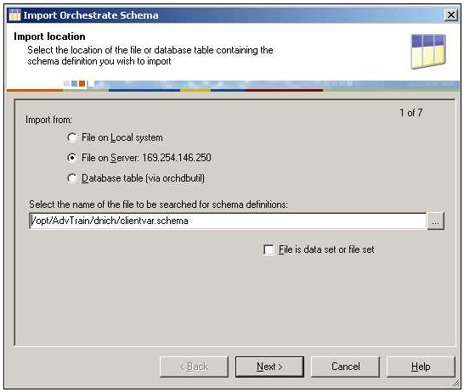
Importing a Schema
Schema location can be server or workstation
Import from Database table
Check if schema is from a data set or file set

Slide 26
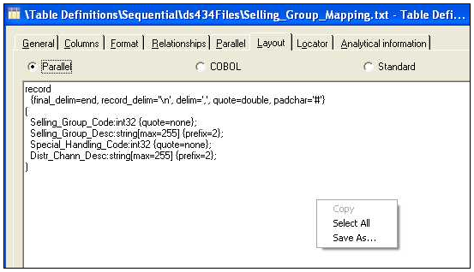
Creating a Schema From a Table Definition
Parallel layout
Layout
Save schema
Schema corresponding
to the Table Definition

Slide 27
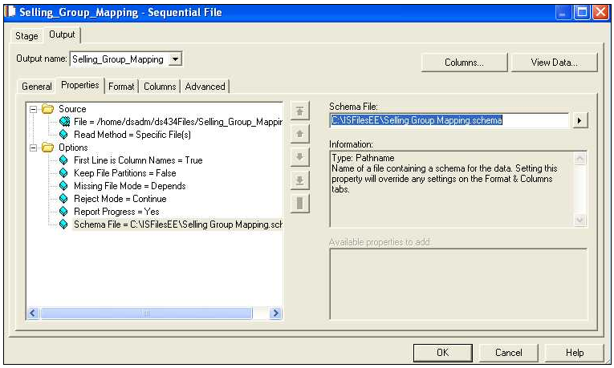
Reading a Sequential File Using a Schema
No columns
defined here
Path to
schema file
Notes:
Schemas can only be used when Runtime Column Propogation is turned on in the stage. This is discussed later in this module.

Slide 28
Runtime Column Propagation (RCP)
When RCP is turned on:
Columns of data can flow through a stage without being explicitly defined in the stage
Target columns in a stage need not have any columns explicitly mapped to them
No column mapping enforcement at design time
Input columns are mapped to unmapped columns by name
How implicit columns get into a job
Read a file using a schema in a Sequential File stage
Read a database table using “Select *”
Explicitly define as an output column in a stage earlier in the flow
Benefits of RCP
Job flexibility
Job can process input with different layouts
Ability to create reusable components in shared containers
Component logic an apply to a single named column
All other columns flow through untouched

Slide 29
Enabling Runtime Column Propagation (RCP)
Project level
DataStage Administrator Parallel tab
Job level
Job properties General tab
Stage level
Link Output Column tab
Settings at a lower level override settings at a higher level
E.g., disable at the project level, but enable for a given job
E.g., enable at the job level, but disable a given stage

Slide 30
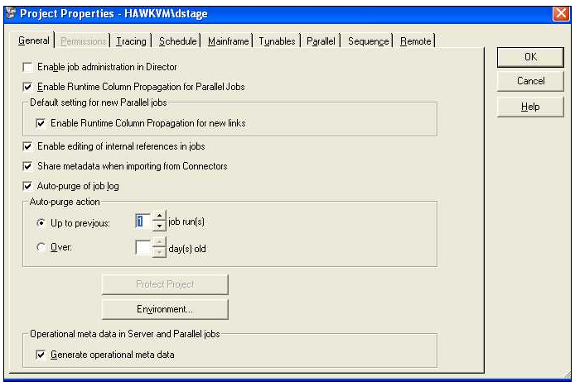
Enabling RCP at Project Level
Check to make RCP
the project default

Slide 31
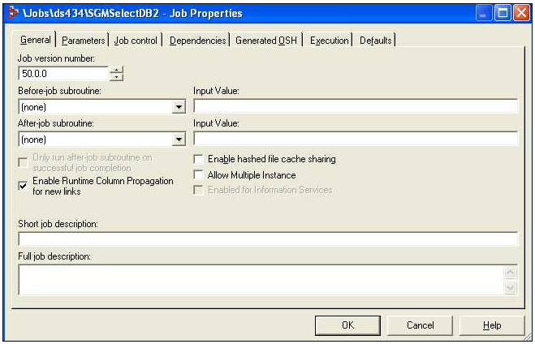
Enabling RCP at Job Level
Check to make
RCP the job default

Slide 32
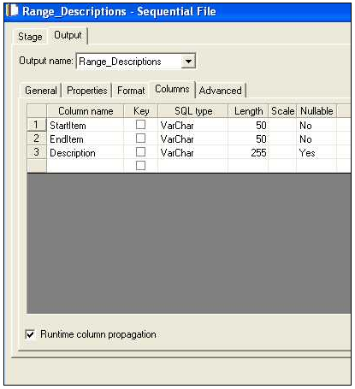
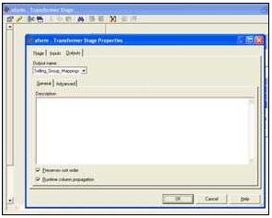
Enabling RCP at Stage Level
Sequential File stage
Output Columns tab
Transformer
Open Stage Properties
Stage Properties Output tab
Enable RCP in
Sequential File
stage
Check to enable
RCP in Transformer

Slide 33
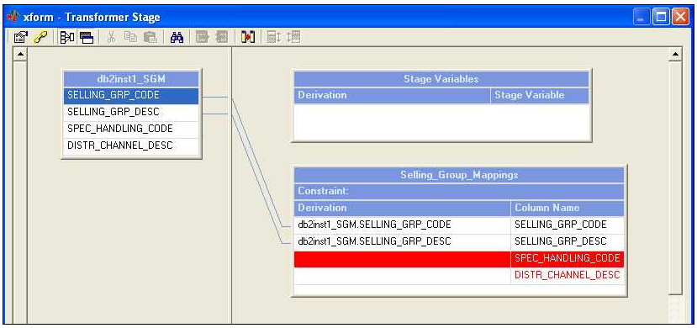
When RCP is Disabled
DataStage Designer enforces Stage Input to Output column mappings.
Colored red; job
won’t compile
Notes:
Modify operators can add or change columns in a data flow.

Slide 34
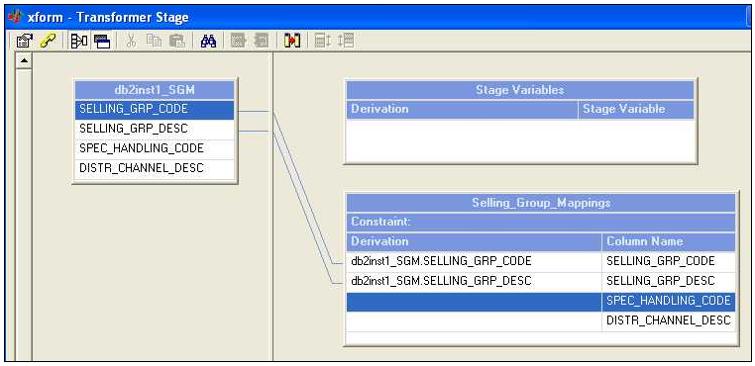
When RCP is Enabled
DataStage does not enforce mapping rules
Runtime error if no incoming columns match unmapped target column names
Job will compile

Slide 35
IBM InfoSphere Information Server
7.5 : Shared Containers

Slide 36
Shared Containers
Encapsulate job design components into a stored container
Provide reusable job design components
Example
Apply stored Transformer business logic

Slide 37
Local Containers and Shared Container
A container, as its name indicates, is used to group stages and links.
Containers help simplify and modularize server job designs and allow you to replacing complex areas of the diagram with a single container stage.
For example, if you have a lookup that is used by multiple jobs, you can put the jobs and links that generate the lookup into a share container and use it to different jobs. In a way, you can look at it like a procedure or function in the programming term.
Containers are linked to other stages or containers in the job by input and output stages

Slide 38
Types of Containers
Two Types:
Local containers
These are created within a job and are only accessible by that job. A local container is edited in a tabbed page of the job’s Diagram window. Local containers can be used in server jobs or parallel jobs.
Shared containers.
These are created separately and are stored in the Repository in the same way that jobs are. There are two types of shared container.

Slide 39
Shared Containers
Server shared container. Used in server jobs (can also be used in parallel jobs). Parallel shared container. Used in parallel jobs. You can also include server shared containers in parallel jobs as a way of incorporating server job functionality into a parallel stage (for example, you could use one to make a server plug-in stage available to a parallel job).

Slide 40
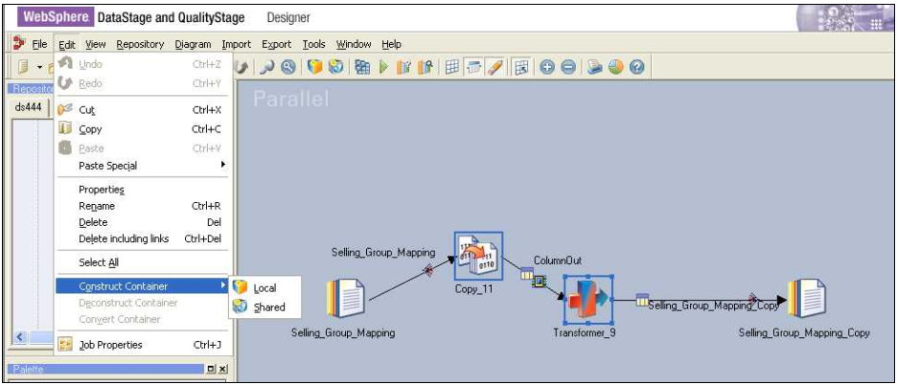
Creating a Shared Container
Select stages from an existing job
Click Edit>Construct
Container>Shared
Selected
components
Click

Slide 41
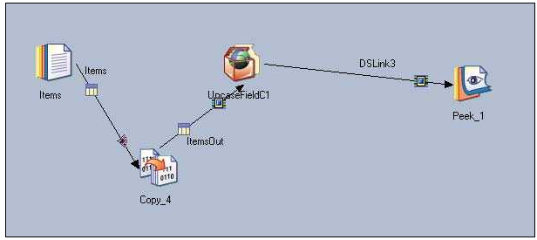
Using a Shared Container in a Job
Shared
Container

Slide 42
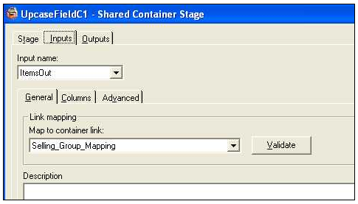
Mapping Input / Output Links to the Container
Select container link
to map input link to

Slide 43
Unit summary
Having completed this unit, you should be able to:
Perform a simple Find
Perform an Advanced Find
Perform an impact analysis
Compare the differences between two Table Definitions
Compare the differences between two jobs
Explain schemas
Create schemas
Explain Runtime Column Propagation (RCP)
Turn RCP on and off
Build a shared container

Slide 44
Q&A
You can compare the differences between what two kinds of objects?
What “wild card” characters can be used in a Find?
You have a job whose name begins with “abc”. You can’t remember the rest of the name or where the job is located. What would be the fastest way to export the job to a file?
Name three filters you can use in a Advanced Find?
What are two benefits of RCP?
What can you use to encapsulate stages and links in a job to make them reusable?

Slide 45
Q&A
Jobs. Table Definitions.
Asterisk (*). It stands for any zero or more characters.
Do a Find for objects matching “abc*”. Filter by type job. Locate the job in the result set, click the right mouse button over it, and then click Export.
Type of object, creation date range, last modified date range, where used, dependencies of, other options including case sensitivity and search within last result set.
Job flexibility. Ability to create reusable components.
Shared containers

Slide 46
IBM InfoSphere Information Server
7.6 : Job Control

Slide 47
Unit objectives
After completing this unit, you should be able to:
Use the DataStage Job Sequencer to build a job that controls a sequence of jobs
Use Sequencer links and stages to control the sequence a set of jobs run in
Use Sequencer triggers and stages to control the conditions under which jobs run
Pass information in job parameters from the master controlling job to the controlled jobs
Define user variables
Enable restart
Handle errors and exceptions

Slide 48
What is a Job Sequence?
A master controlling job that controls the execution of a set of subordinate jobs
Passes values to the subordinate job parameters
Controls the order of execution (links)
Specifies conditions under which the subordinate jobs get executed (triggers)
Specifies complex flow of control
Loops
All / Some
Wait for file
Perform system activities
Email
Execute system commands and executables
Can include Restart checkpoints

Slide 49
Basics for Creating a New Job Sequence
Open a new job sequence
Specify whether its restartable
Add stages
Stages to execute jobs
Stages to execute system commands and executables
Special purpose stages
Add links
Specify the order in which jobs are to be executed
Specify triggers
Triggers specify the condition under which control passes across a link
Specify error handling
Enable / Disable restart checkpoints

Slide 50
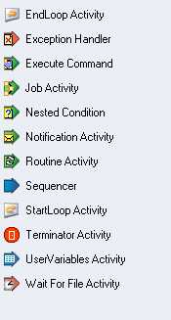
Job Sequencer Stages
Run stages
Job Activity: Run a job
Execute Command: Run a system command
Notification Activity: Send an email
Flow control stages
Sequencer: Go if All / Some
Wait for File: Go when file exists / doesn’t exist
Start Loop / End Loop
Nested Condition: Go if condition satisfied
Error handling
Exception Handler
Terminator
Variables
User Variables

Slide 51
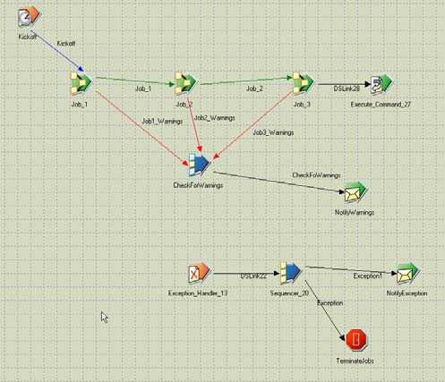
Example
Wait for file
Execute a
command
Send email
Run job
Handle
exceptions

Slide 52
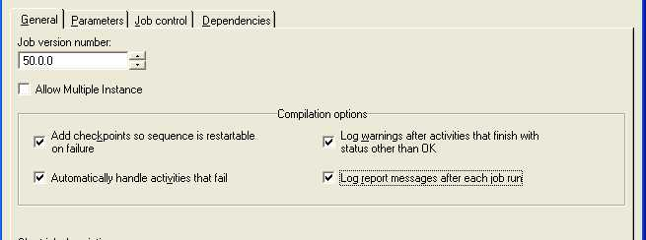
Sequence Properties
Restart
Exception stage to
handle aborts

Slide 53
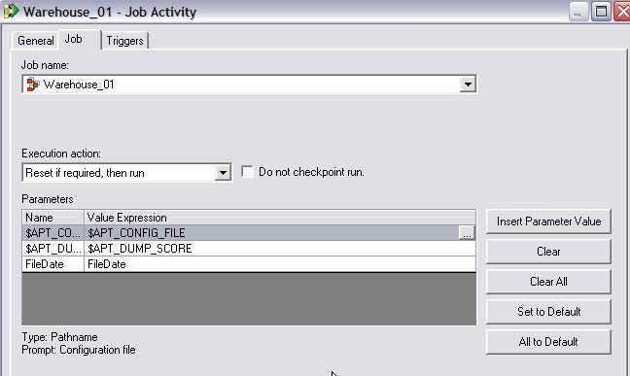
Job Activity Stage Properties
Job to be executed
Execution mode
Job parameters
to be passed

Slide 54
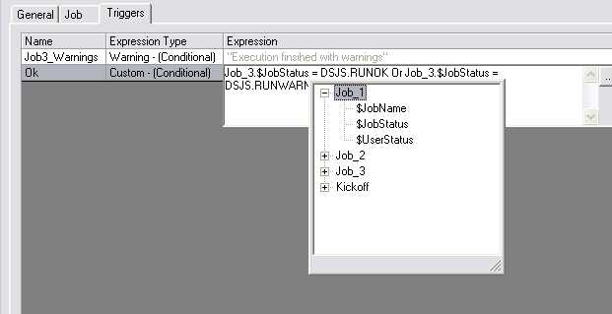
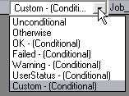
Job Activity Trigger
Output link names
List of trigger types
Build custom trigger
expressions

Slide 55
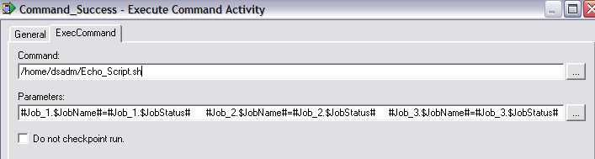
Execute Command Stage
Executable
Parameters to pass
Execute system commands, shell scripts, and other executables
Use e.g. to drop or rename database tables

Slide 56
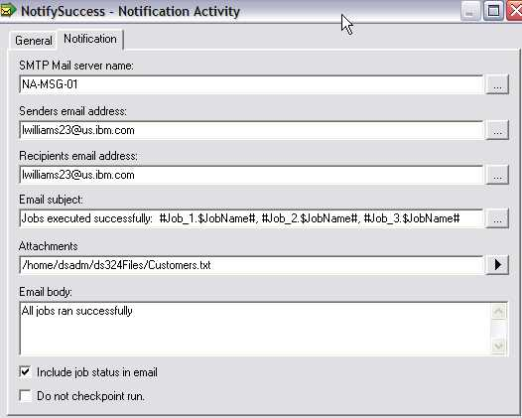
Notification Activity Stage
Include job
status info in
email body

Slide 57
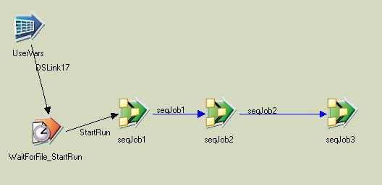
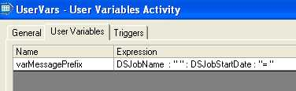
User Variables Stage
User Variables stage
Variable
Expression defining the
value for the variable

Slide 58
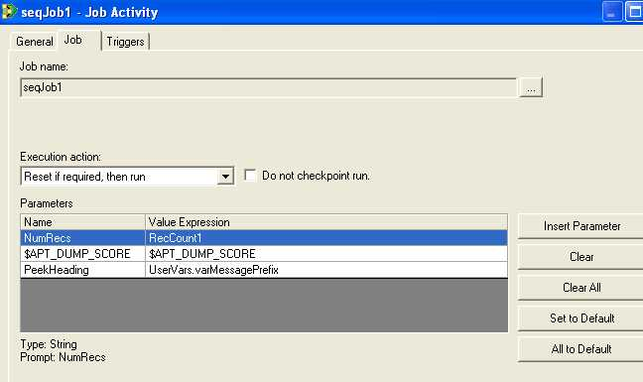
Referencing the User Variable
Variable

Slide 59
IBM InfoSphere Information Server
7.7 : Flow of Control Stages

Slide 60
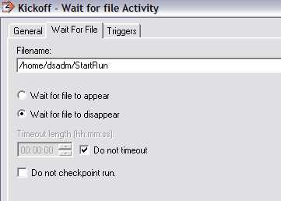
Wait for File Stage
File
Options

Slide 61
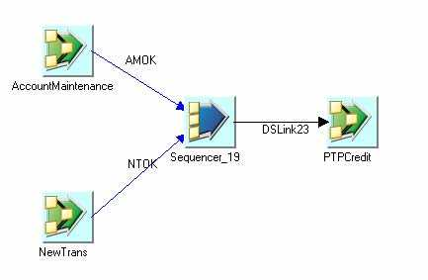
Sequencer Stage
Sequence multiple jobs using the Sequence stage
Can be set to
all or any

Slide 62
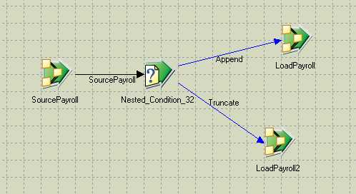
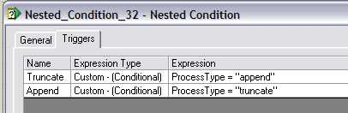
Nested Condition Stage
Fork based on trigger
conditions
Trigger conditions

Slide 63
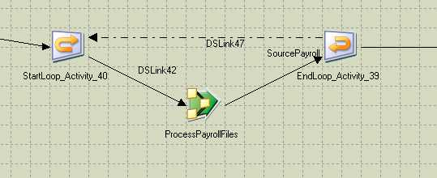
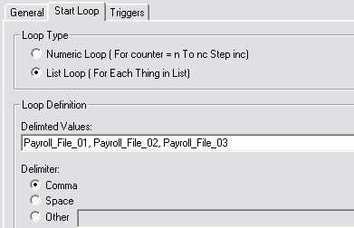
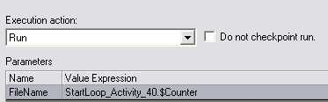
Loop Stages
Reference link to start
Counter values
Pass counter value

Slide 64
IBM InfoSphere Information Server
7.8 : Error Handling

Slide 65
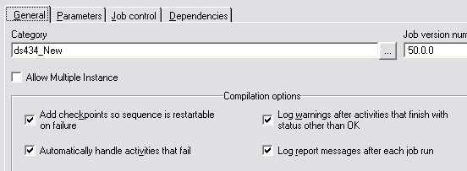
Handling Activities that Fail
Pass control to Exception stage when an activity fails

Slide 66
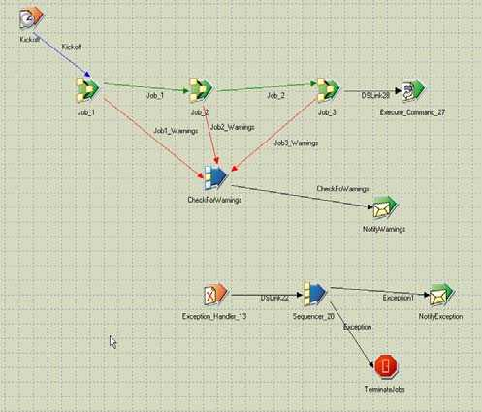
Exception Handler Stage
Control goes here if
an activity fails

Slide 67
IBM InfoSphere Information Server
7.8 : Restart

Slide 68
Enable Restart
Enable checkpoints to be added
Notes:
If a Sequence fails, and it is set to "Add check points so sequence is restartable on failure", then when the Sequence is re-run, activities that completed successfully in the prior run are skipped over (unless the "Do not checkpoint run" option was set for an activity).

Slide 69
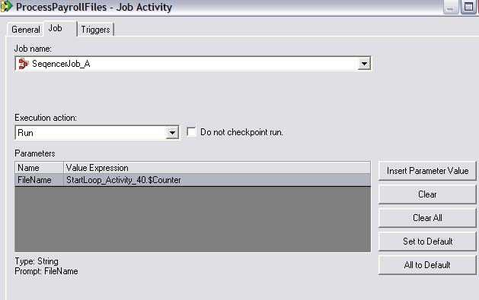
Disable Checkpoint at a Stage
Don’t checkpoint
this activity

Slide 70
Q & A
Which stage is used to run jobs in a job sequence?
Does the Exception Handler stage support an input link?

Slide 71
Q & A
Job Activity stage
No, control is automatically passed to the stage when an exception occurs.

Slide 72
Unit summary
Having completed this unit, you should be able to:
Use the DataStage Job Sequencer to build a job that controls a sequence of jobs
Use Sequencer links and stages to control the sequence a set of jobs run in
Use Sequencer triggers and stages to control the conditions under which jobs run
Pass information in job parameters from the master controlling job to the controlled jobs
Define user variables
Enable restart
Handle errors and exceptions

